Slide 1
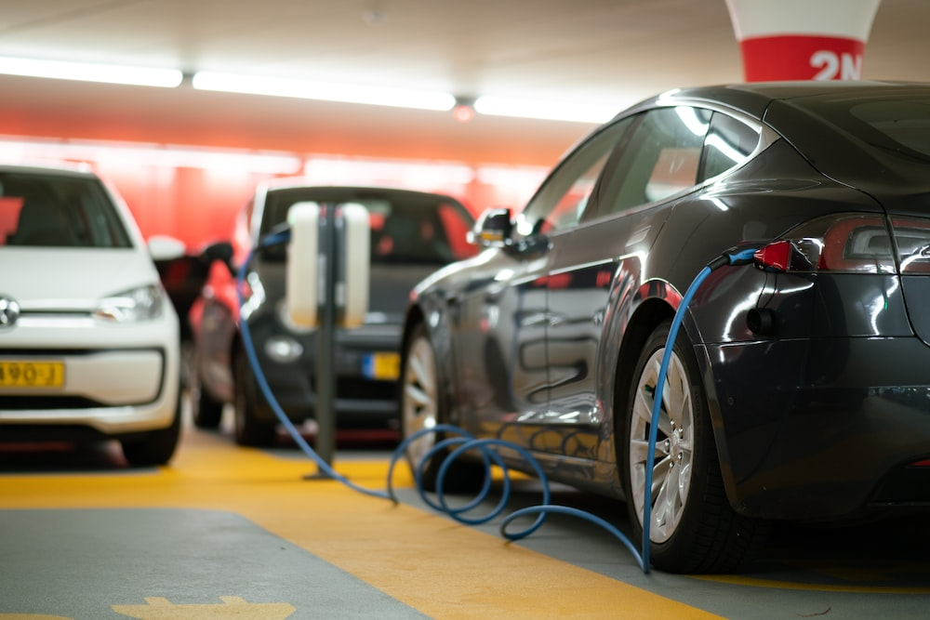
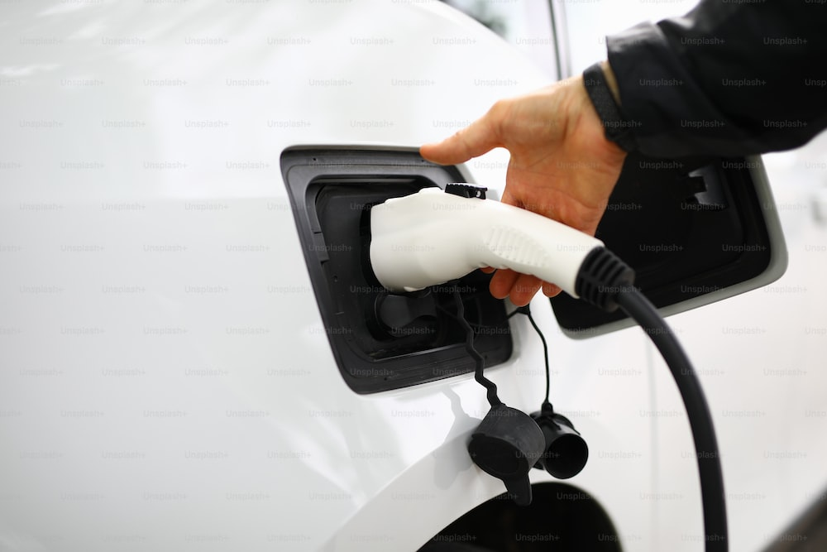



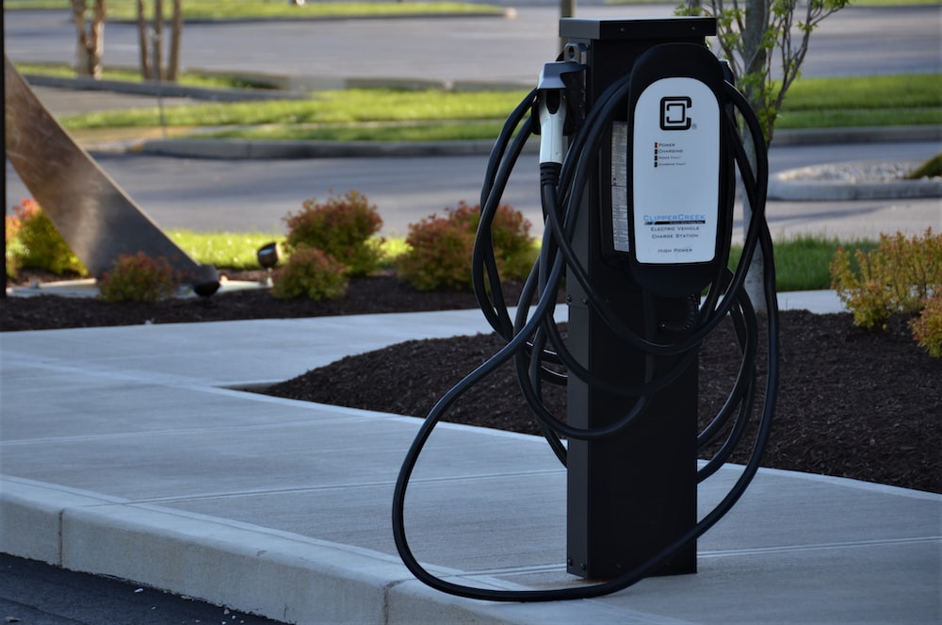
UTC-7SPC Meeting
EV Charging Datasets and Potential Projects

Slide 2
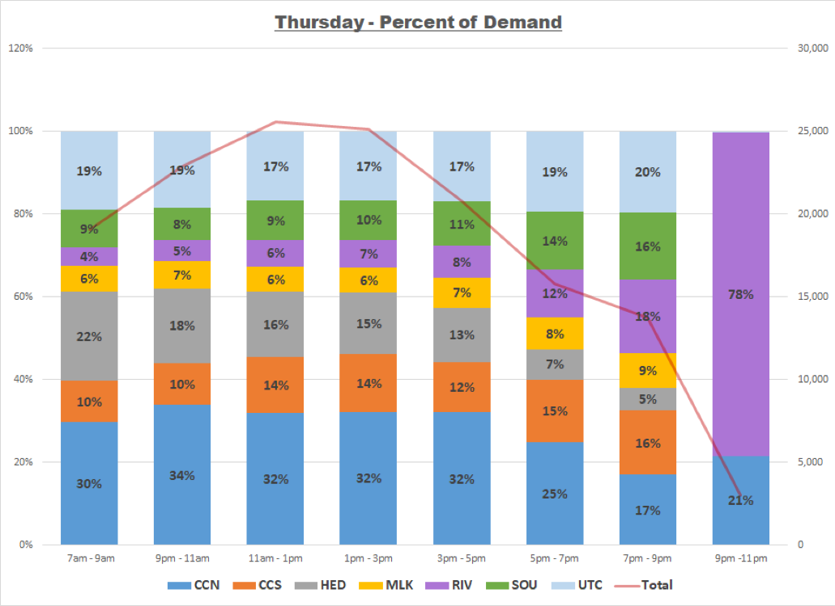
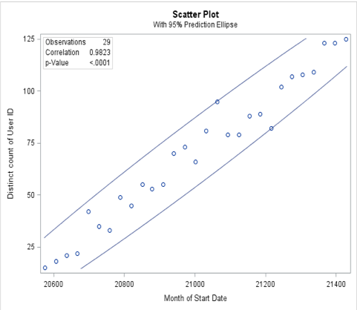
Priority 1
Problem 1 - How to measure the viability of Level 2 and DC fast charging sites in 5 years (after grant funding, which sites will be worth investing in to keep running)
Approach – Individual EV and general utilizations will be the most important metric to consider.
Prior Projects – We have done a similar study mostly focused on demand forecast using EV charging data from CARTA* from various points of view:
Number of charging events
Number of unique EVs
Energy demands
*Chattanooga Area Reginal Transportation Authority

Slide 3
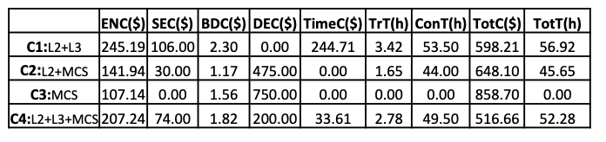
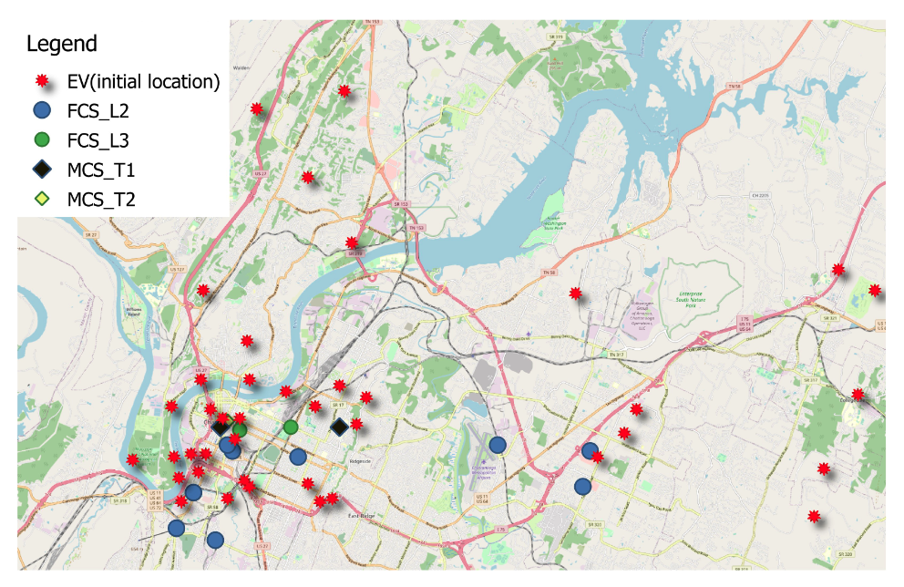
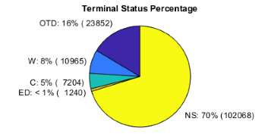
Priority 2
Problem 2 - What is the optimal power per port ratio in Urban vs Rural vs Interstate locations? When does adding more power to a site have diminishing returns?
Approach – Identifying both obvious and hidden demands for different power rates. Run optimization to define the best ratios.
Obvious demand is the actual demand that has been recorded in data
Hidden demand or demand not met is the one that has not been met because the EV user has not been able to find a charging station
Metrics – Location, utilization of charging stations, average parking and charging times, number of events, types of cars visiting.

Slide 4
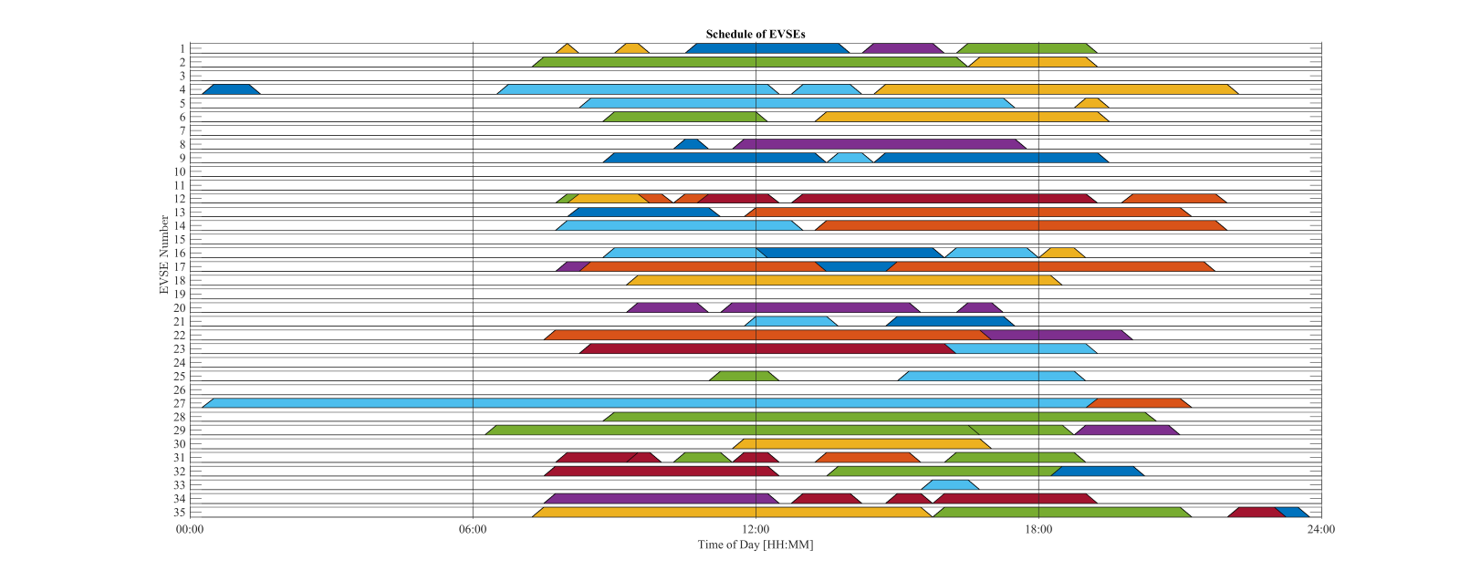
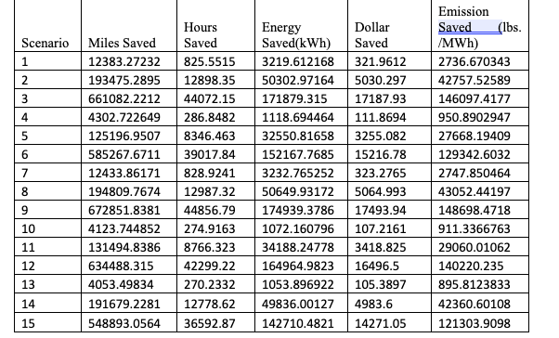
Priority 3
Problem 4 - Tools for measuring/reporting location based GHG savings based on Valley generation mix (not national averages)
Approach – Crossing charging event data with the generation mix data and studying the GHG saving.
Using power flow analysis approaches, we will define the marginal impacts of each charging station and study the GHG impact.
Prior projects – Multiple power flow analysis and optimization projects. GHG impact studies using CARTA data.
Studied the impact of optimal scheduling on different operation parameters including GHG emmissions

Slide 5
Problems 1 and 2
Analysis of EV Charging Stations Exploring Viability, User Behavior, and Station Utilization

Slide 6
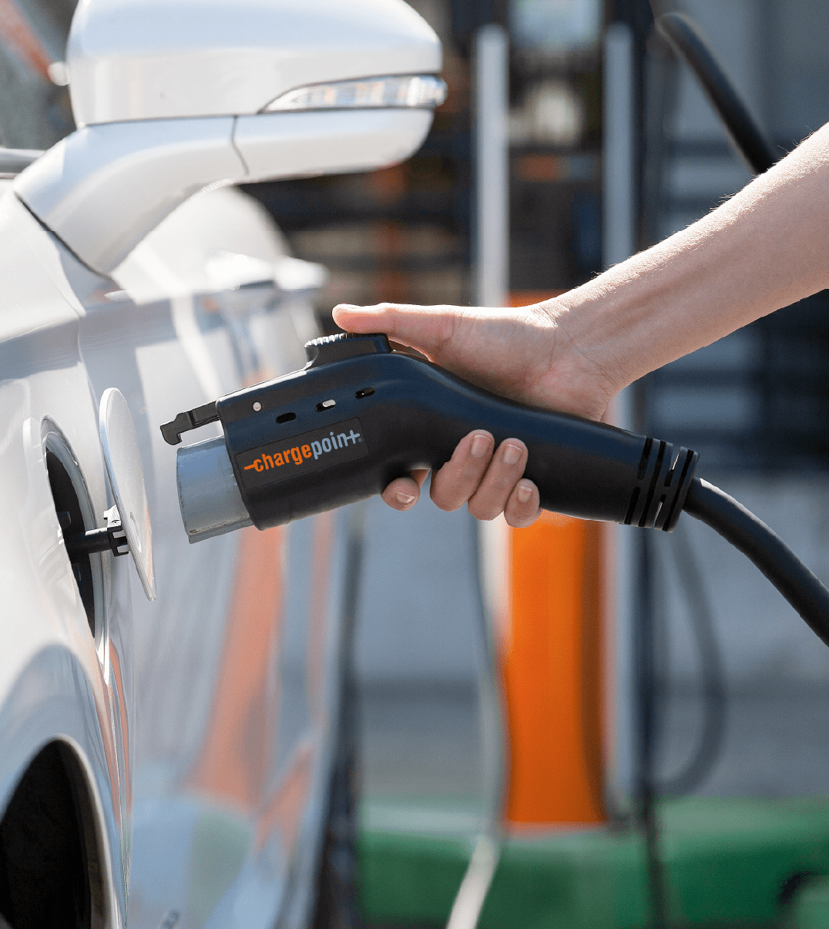
How to measure the viability of Level 2 and DC fast charging sites in 5 years (after grant funding, which sites will be worth investing in to keep running)
What is the optimal power per port ratio in Urban vs Rural vs Interstate locations? When does adding more power to a site have diminishing returns?

Slide 7







Viability of Level 2 and DC fast charging sites
Data Gathering

Slide 8
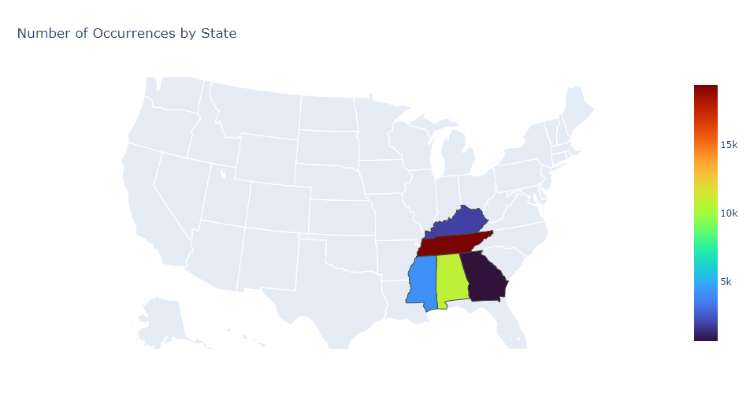
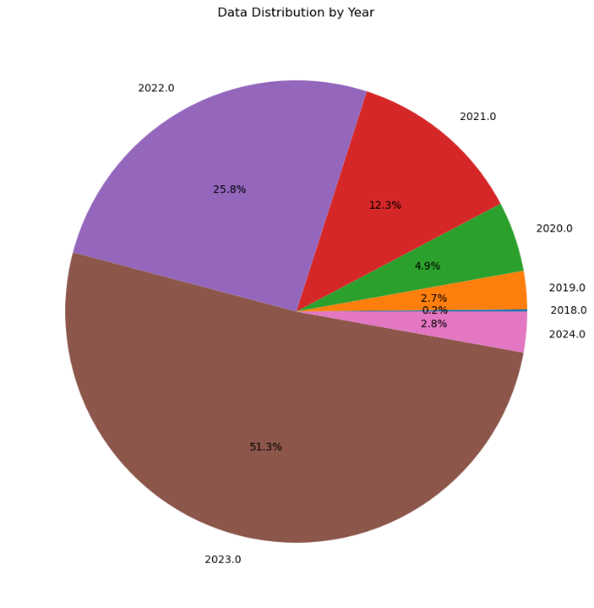
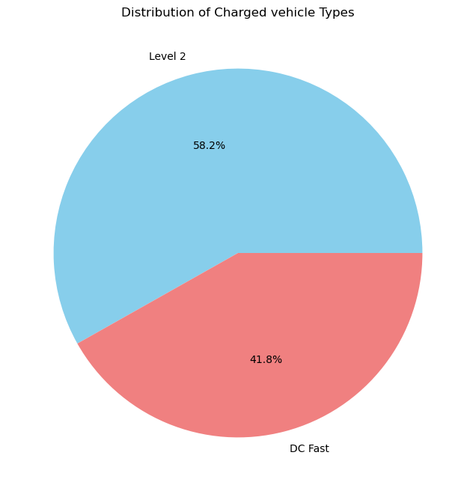
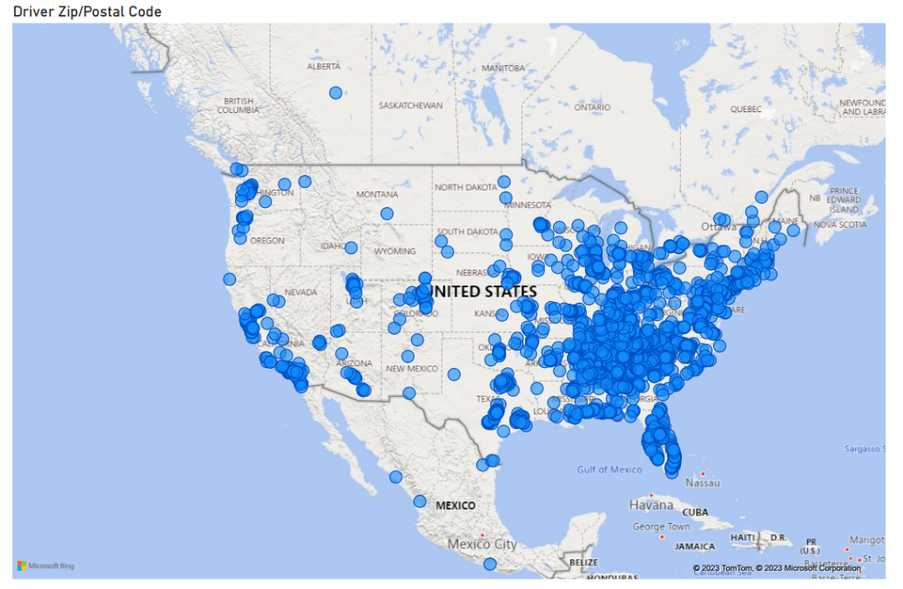
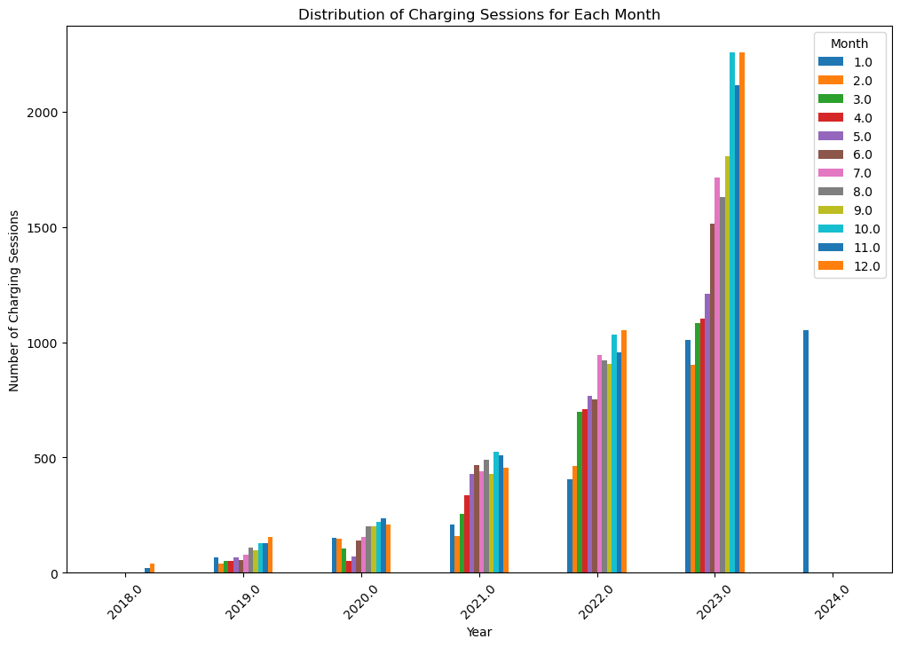
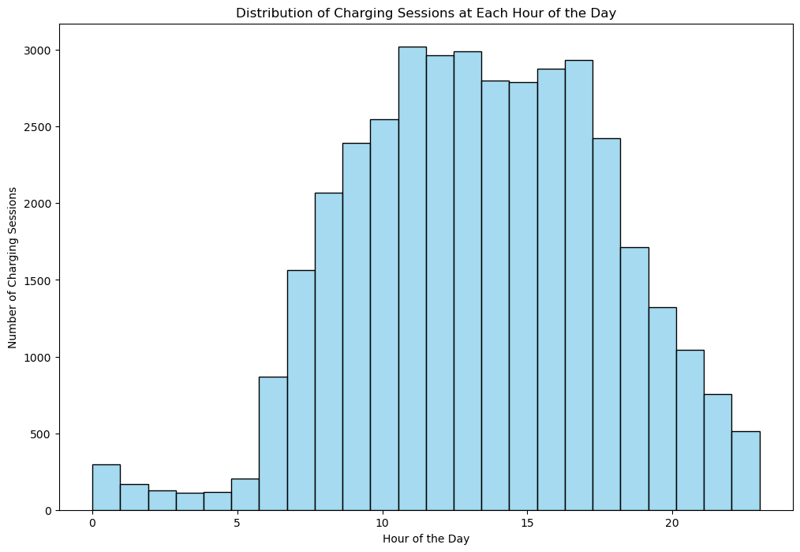
Distribution of data
Distribution by year
Distribution of vehicle type
Total Charging Stations: 93
Dec. 2018 – Jan 2024
State
Tennessee 19372
Alabama 10803
Mississippi 4146
Kentucky 1931
Georgia 691
Charging Session Over Time
Contribution of Charging Session during the day
Driver Zip Code

Slide 9
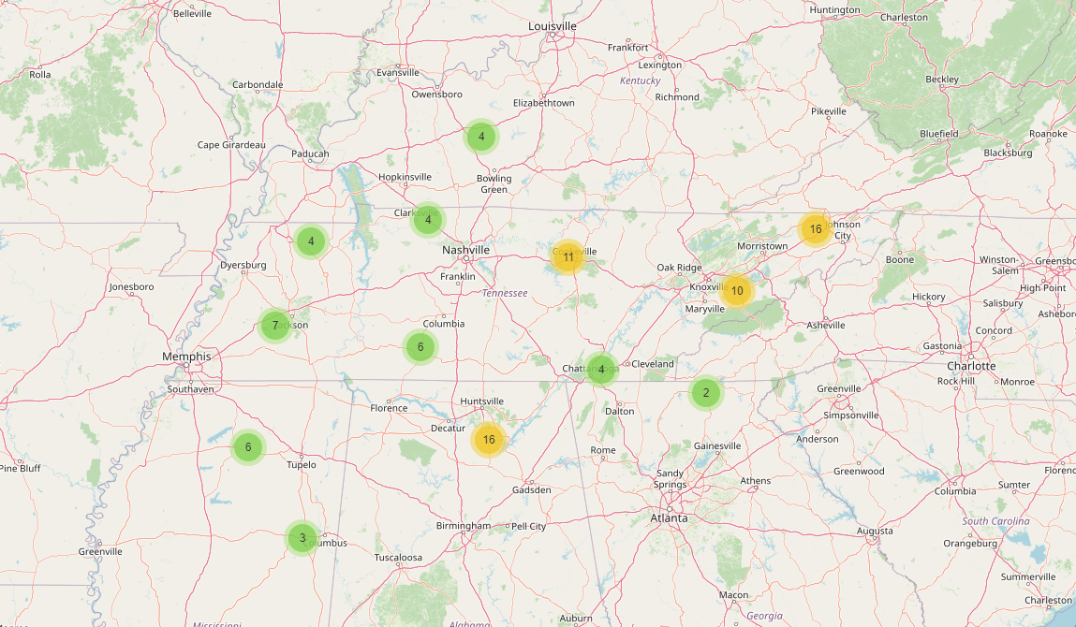
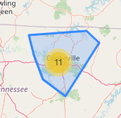
Charging station locations

Slide 10


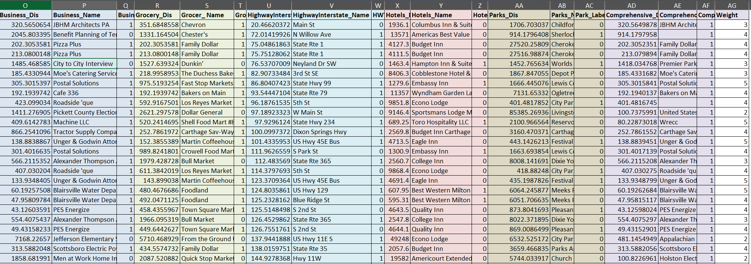
Data fusion- Charging Venue Analysis
Understanding the distribution of electric vehicle charging stations across different venues provides valuable insights into the accessibility and strategic placement of charging infrastructure.
Walking distance
UTC-IGTLab
A list of potential charging venues, including hotels, leisure facilities, medical centers, city halls, offices, parking areas, retail establishments, and transit hubs, Hwy,…
Charging Venue
CS (Lat, Long)

Slide 11



Data Analysis
User Data
CS Data
Charging Time
Location
EVSE ID
Event Type
Parking Time
Number of Ports
POI-Venue
Charging Status
Ports Type (L2/DCFC)
Service Time
User Zip Code
Idle Time
Out of Service Time
Delivered Energy (kWh)
D/W/M/Y Delivered Energy
Free/Paid
Fee
Hidden Demand
Current Demand
Start Charging
End Charging
Leaving CS
Start Charging
End Charging
Leaving CS
Charging
Parking
Idle time
Charging
Parking
Total duration
Total duration
Timeline

Slide 12
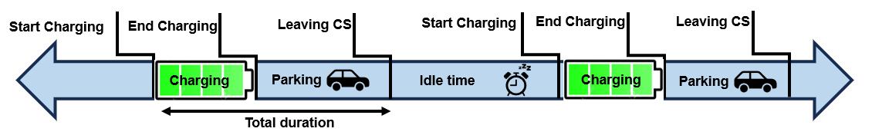
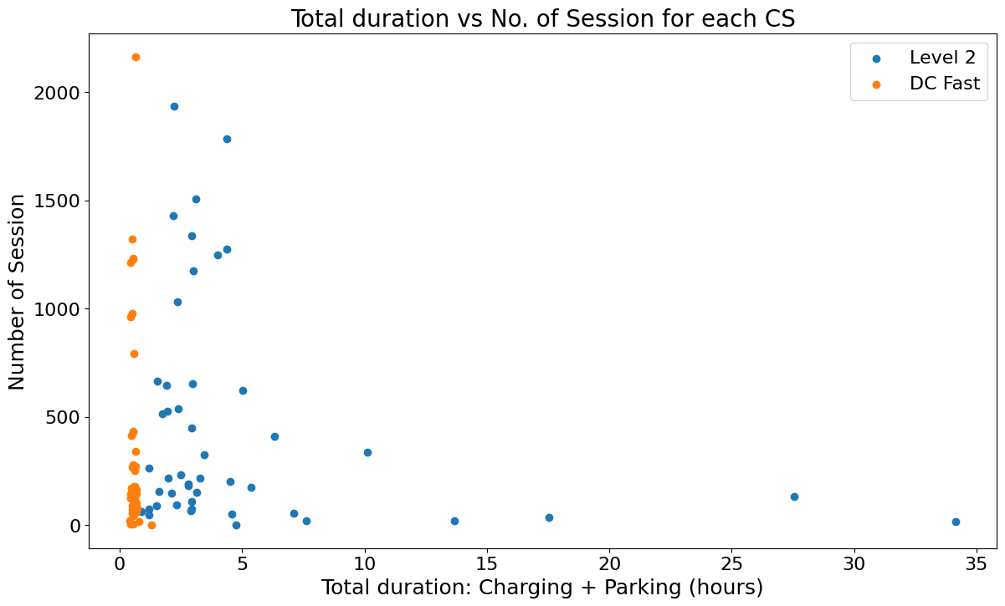
Decision Making
Measure the viability of Level 2 and DC fast charging sites:
Study of user's behavior, charging time, parking time, related to each CS and POI
Each point represent the average charging + parking time at each EVSE

Slide 13
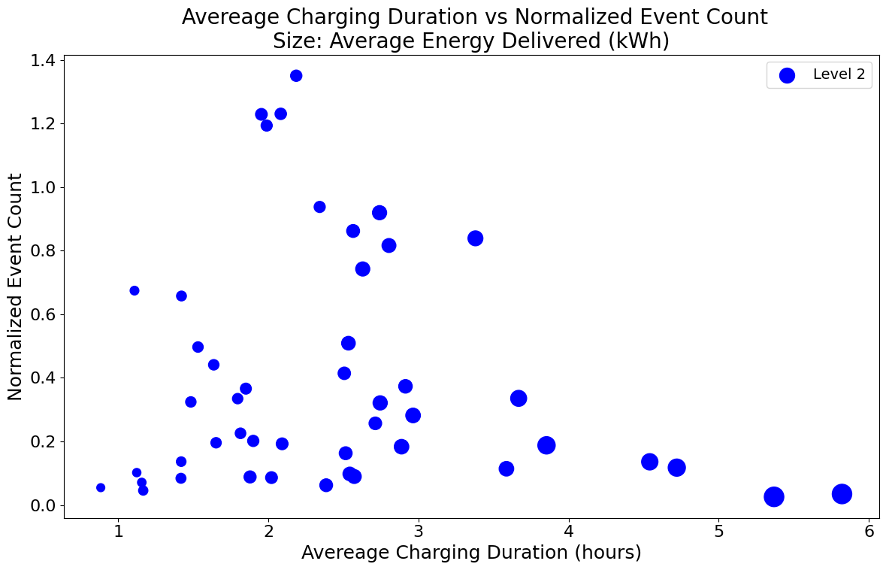
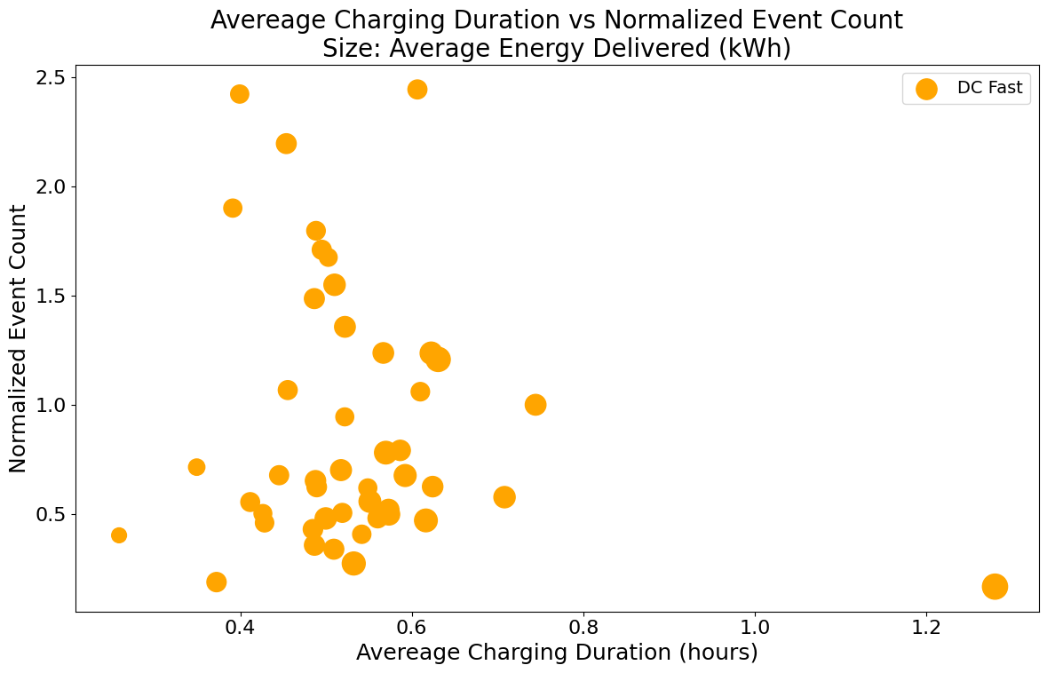
Decision Making
Each point represent the average charging time and the size is average of delivered energy (kWh) at each EVSE
Less charging time
+
lower demand
Less charging time
+
lower demand
EVSE ID: 5498461
Av. charging time: 48 min
Number of session: 63

Slide 14
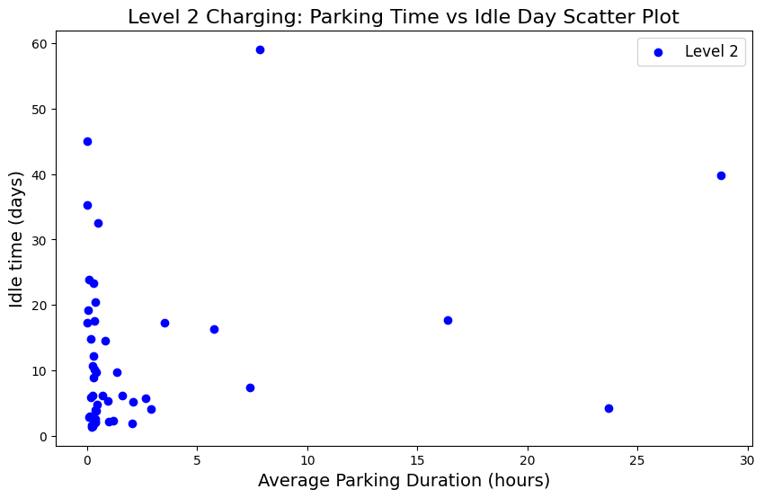
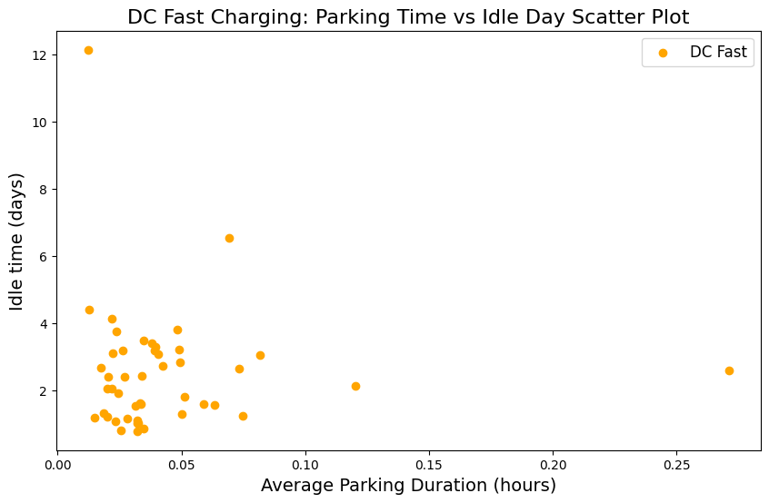
Decision Making
Idle time is the time between two session which is not any EV pugged in and charging port is empty
Area with high parking time and lower demand

Slide 15
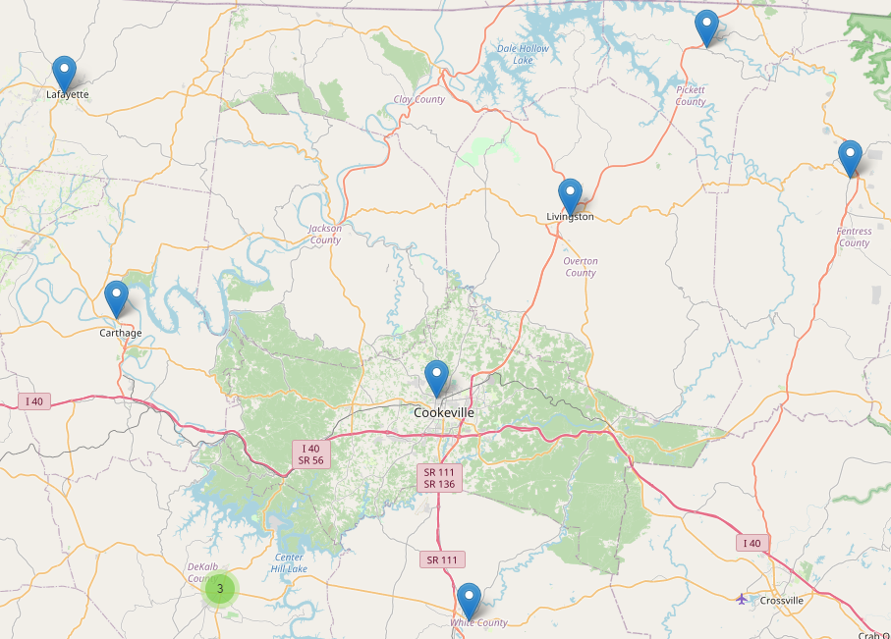



Decision Making
What will happen if we decide to run out a Charging Station?

Slide 16
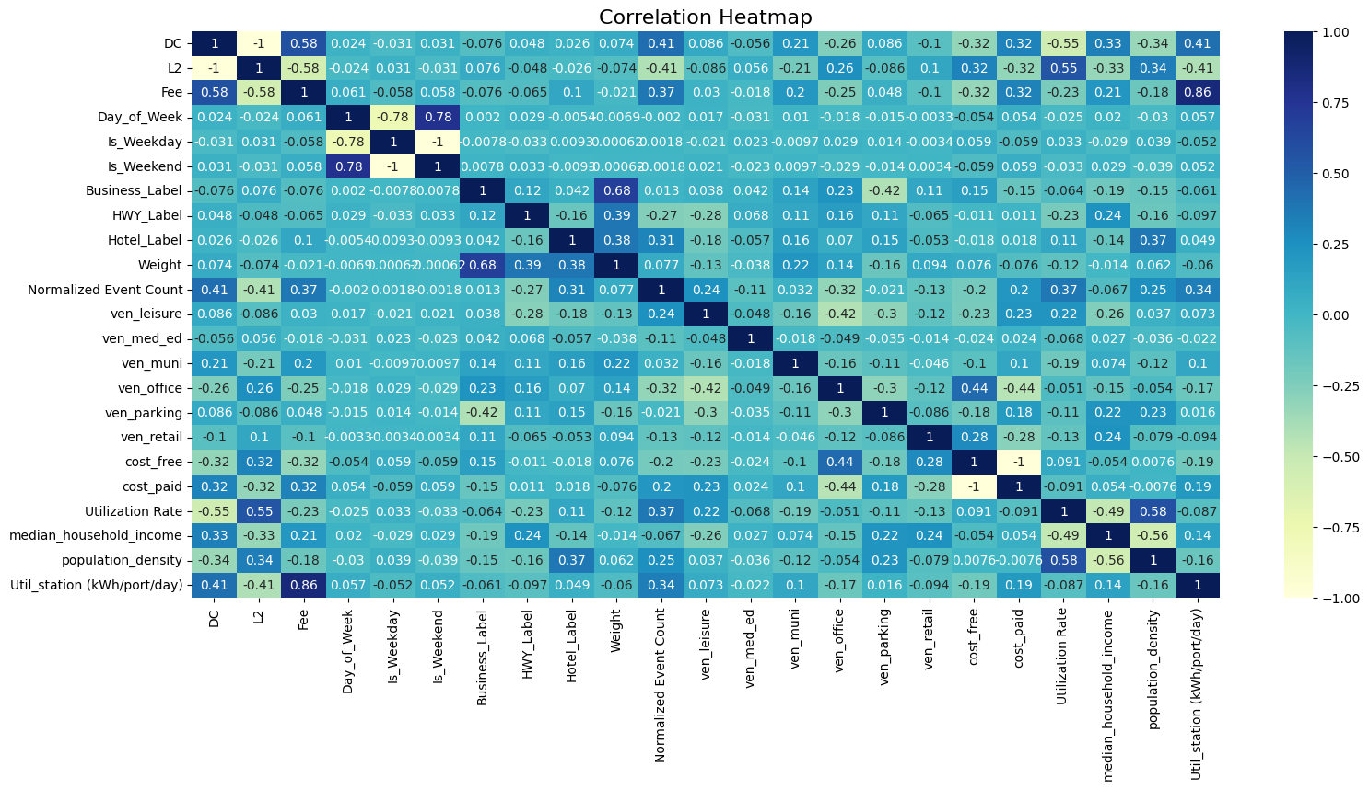
Data processing
Machine learning
station utilization prediction (kWh/port/day)
Row data
Random Forest:
Prediction
Train Score = 0.86
Test Score = 0.83
Val Score = 0.82
Correlation Heatmap

Slide 17

Questions and Discussions (Part 1)

Slide 18
Problem 4
Models and Tools for Exact GHG Emission Saving Based on Spatiotemporal Generation Mix

Slide 19
EV Charging Datasets and Potential Projects
Problem 4 - Tools for measuring/reporting location based GHG savings based on Valley generation mix (not national averages)
Overview and Methodology:
Saved GHG Emissions in Transportation Mode:
Using EVs instead of ICE Vehicles: not burning gasoline
Additional GHG Emissions in Charging Mode:
Emissions due to electricity generations in power plants
Common Practice and Caveat:
GHG saving models often consider national average: one number for all regions at all times
GHG emission varies with generation mix in different grids at different times
Our Goal:
Develop a model to quantify net CO2 reduction due to EV charging considering regional hourly energy mix
CO2 injection
Net CO2
CO2 reduction by EV Using
Energy required
EV Charging
Energy yield
In
Out

Slide 20
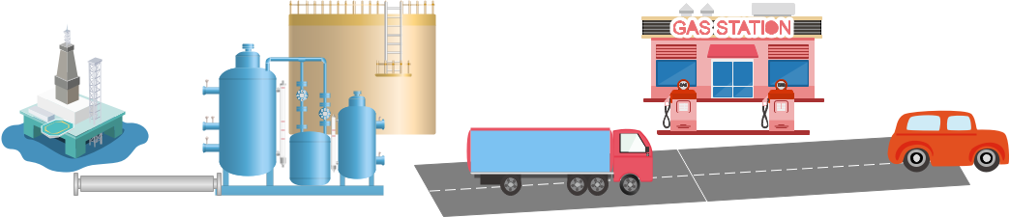
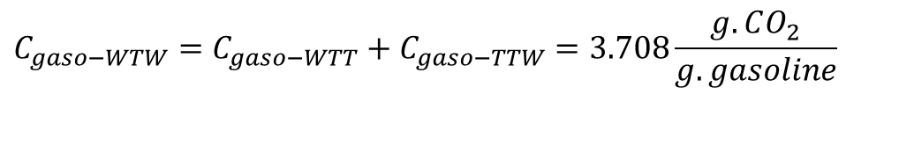
Problem 4 - Tools for measuring/reporting location based GHG savings based on Valley generation mix (not national averages)
GHG Emissions of Driving ICE Vehicles
Tank-To-Wheel (TTW)
Well-To-Tank (WTT)
Well to wheel (WTW)
$$C_{gaso−WTW}=C_{gaso−WTT}+C_{gaso−TTW}=3.708\frac{g.CO_{2}}{g.gasoline}$$

Slide 21

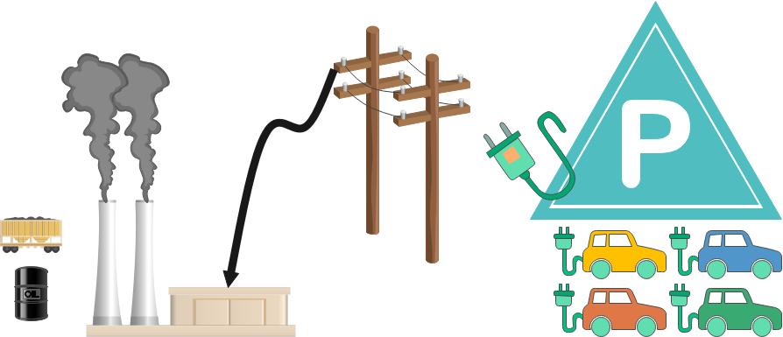
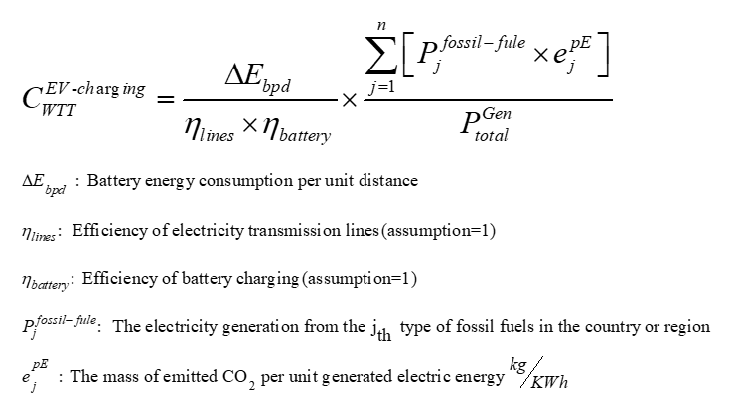
Problem 4 - Tools for measuring/reporting location based GHG savings based on Valley generation mix (not national averages)
GHG Emissions of Driving EV
Well-To-Tank (WTT)
Comprehensive CO2 emissions analysis and optimization of plug-in hybrid electric vehicles, Journal of Automobile Engineering. 2023;

Slide 22


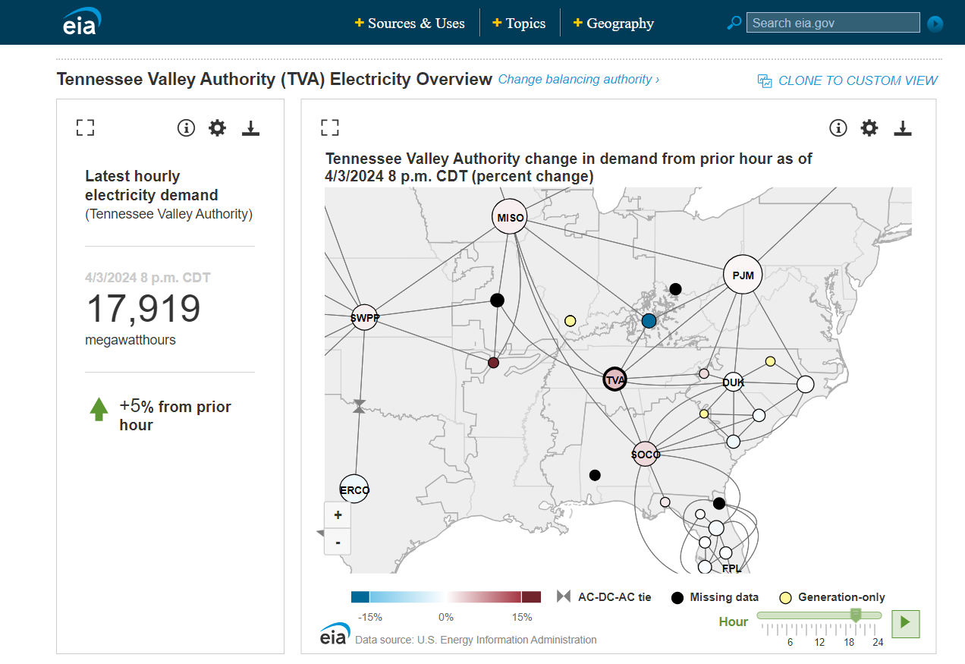
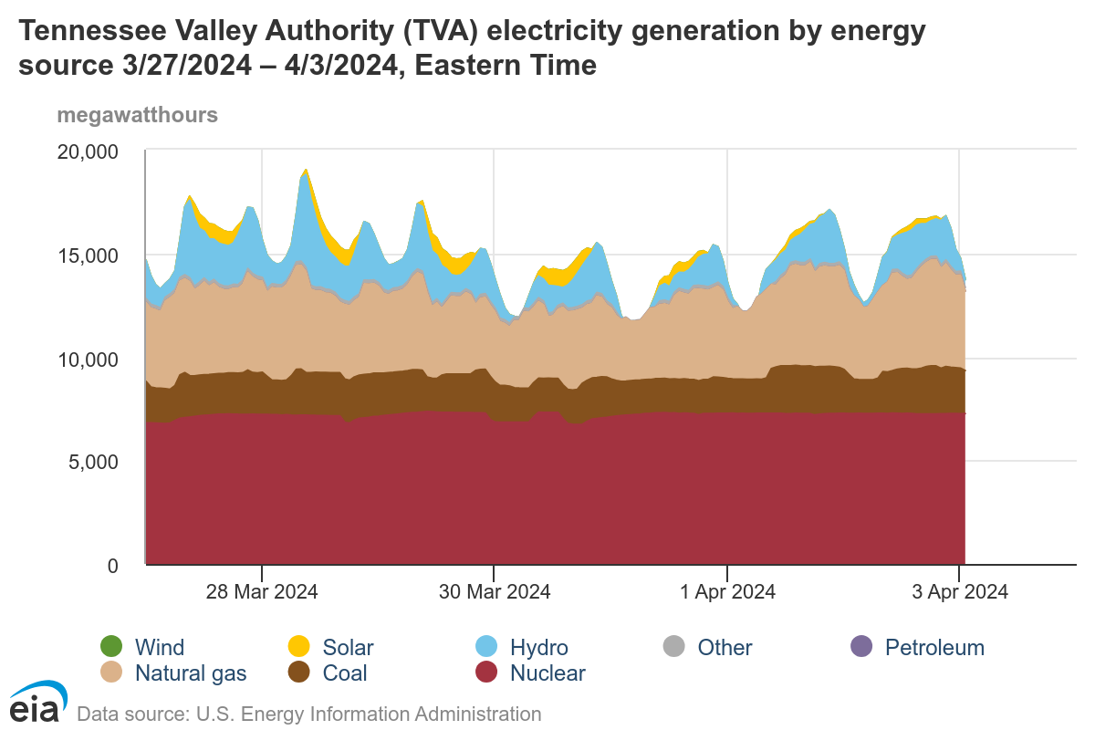
Problem 4 - Tools for measuring/reporting location based GHG savings based on Valley generation mix (not national averages)
Approach:
Determining marginal emissions estimation for TVA based on the combination of electricity generation by energy sources
https://www.eia.gov/electricity/gridmonitor/dashboard/electric_overview/balancing_authority/TVA

Slide 23
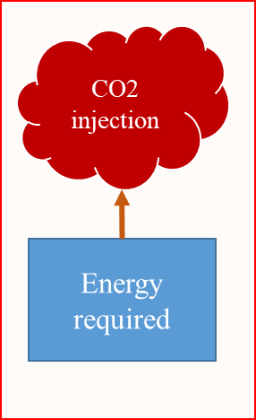
Problem 4 - Tools for measuring/reporting location based GHG savings based on Valley generation mix (not national averages)
Approach:
The average mass of emitted CO2 per unit generated electric energy kg/KWh
(MWh)
The State Electricity Profiles
U.S. Electric Power Industry Estimated Emissions by State
Calculating the average emission g/KWh
https://www.eia.gov/

Slide 24
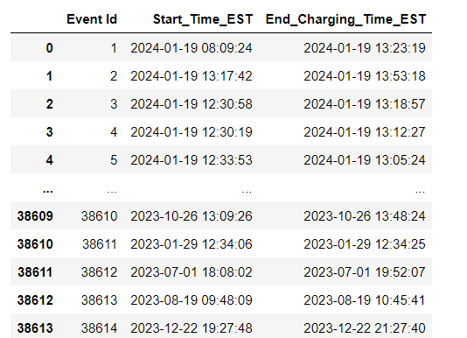
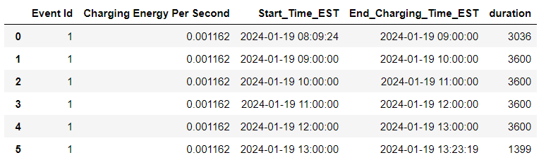
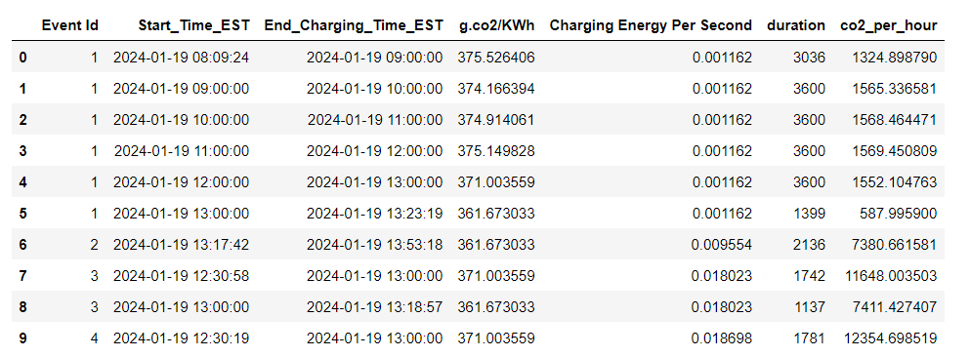
Problem 4 - Tools for measuring/reporting location based GHG savings based on Valley generation mix (not national averages)
Approach:

Slide 25
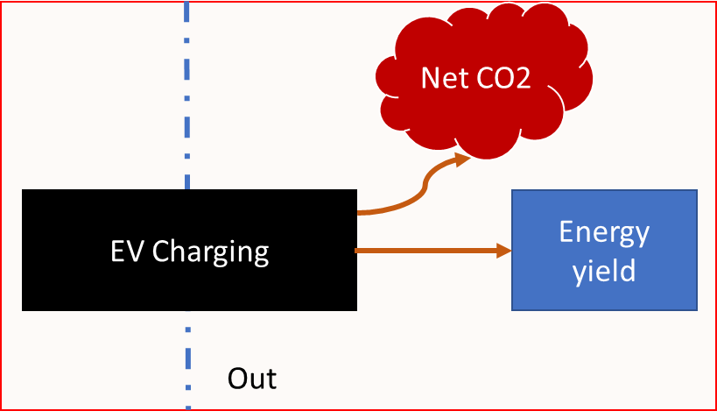
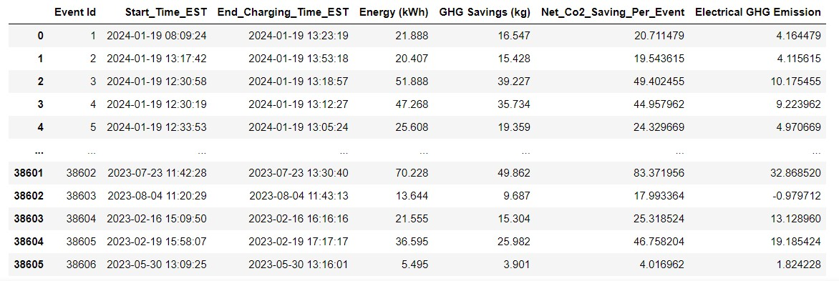
Problem 4 - Tools for measuring/reporting location based GHG savings based on Valley generation mix (not national averages)
Approach:
The amount of co2 saving obtained from each electric vehicle charging event using the introduced method is lower in some events and higher in some events than the amount declared in Seven State information. The reason for this difference is the accuracy of the method used, which calculates the amount of CO2 in each hour according to the composition of the type of power plant generation of that hour.

Slide 26
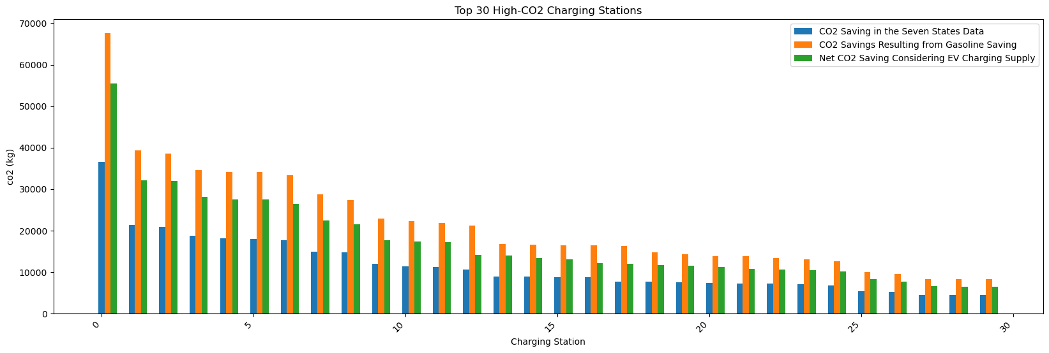
Problem 4 - Tools for measuring/reporting location based GHG savings based on Valley generation mix (not national averages)
Result:
Comparing the value of saving CO2 for 30 electric vehicle charging stations in the introduced method and seven-state information
CO2 Saving in the Seven States Data
CO2 savings resulting from gasoline saving
Net CO2 Saving Considering EV Charging Supply

Slide 27
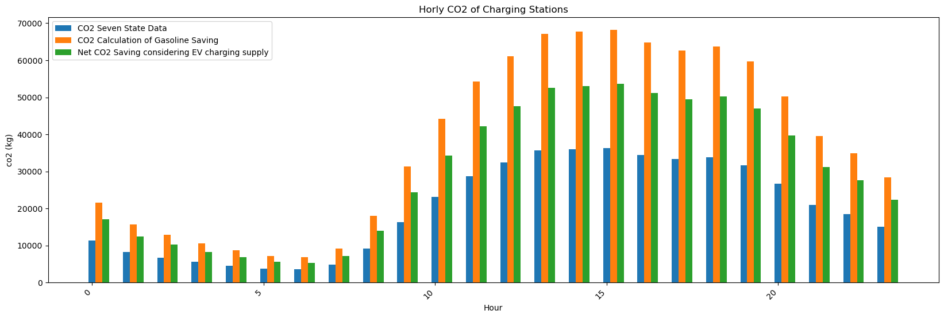
Problem 4 - Tools for measuring/reporting location based GHG savings based on Valley generation mix (not national averages)
Result:
Comparing the value of hourly CO2 saving in the introduced method and seven-state information

Slide 28
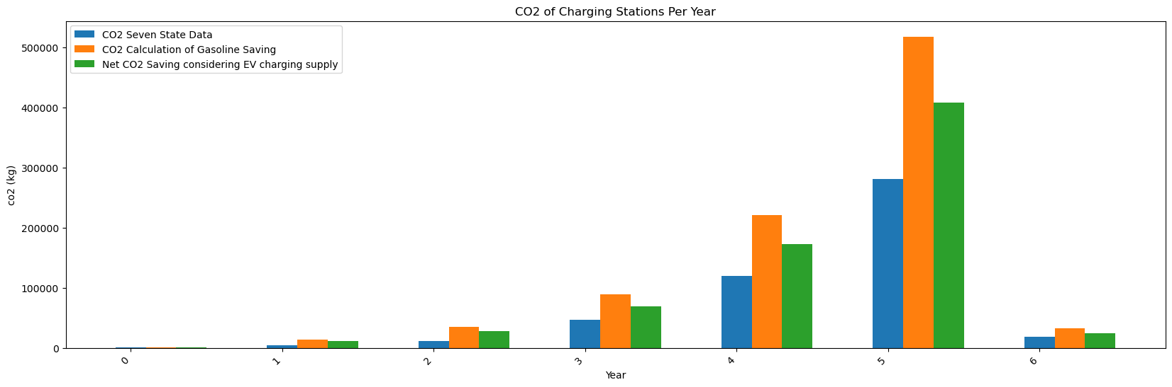
Problem 4 - Tools for measuring/reporting location based GHG savings based on Valley generation mix (not national averages)
Result:
Comparing the value of saving CO2 per year in the introduced method and seven-state information

Slide 29
Problem 4 - Tools for measuring/reporting location based GHG savings based on Valley generation mix (not national averages)
GHG Saving Control:
Challenges
Objectives
Optimal Scheduling of EV Charging
Maximize GHG Saving
Different Arrival and Departure Time of Electric Vehicles
Different Charging Demands
Maximizing the Revenue of Charging Stations
The Combination of Power Grid Energy Generation
Investigating the Impact on the Power Grid
Different g.CO2 Rates Per Hour
Charging Scheduling Considering Maximum Social Welfare

Slide 30
Questions and Discussions (Part 2)

